Slide 1
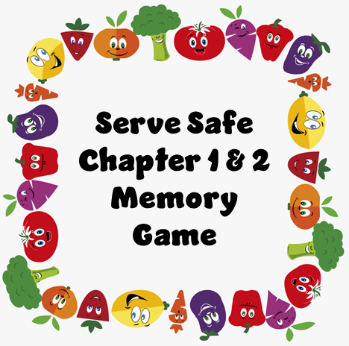
Serve Safe
Chapter 1 & 2
Memory Game

Slide 2
A disease transmitted to people by food.
Food – borne illness
Outbreak
2 or more people have the same symptoms after eating the same food.
An investigation is conducted by state and local regulatory authorities.
Confirmed by a laboratory analysis.
Biological
Chemical
Physical
Contaminants

Slide 3
Ready-to-eat food
High-Risk Population
TCS
Food that can be eaten without further preparation.
Elderly
Preschool-age children
People with compromised immune systems
Time and Temperature Control for Safety

Slide 4
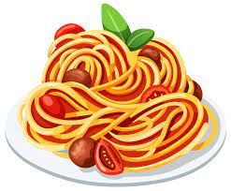
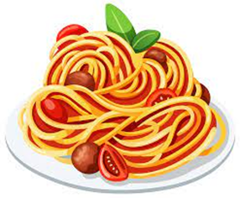
CDC & PHS
FDA
USDA
Inspects all food except meat, poultry and eggs
Regulates and inspects meat, poultry, and eggs
Conduct research into the causes of foodborne-illness outbreaks

Slide 5
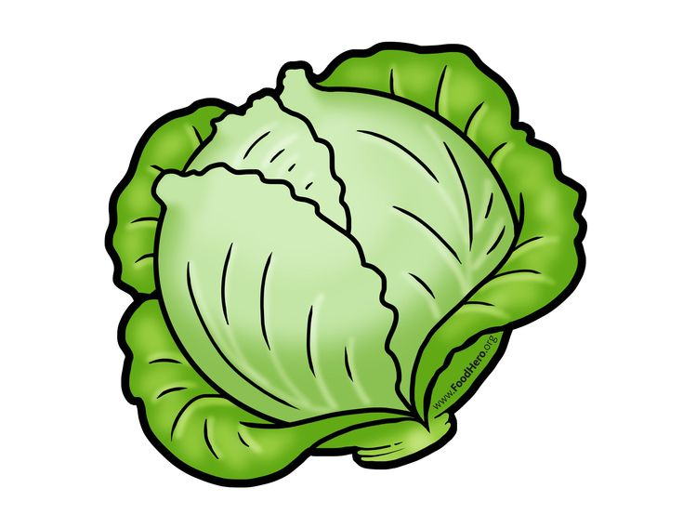
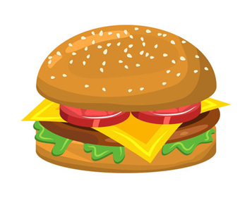
Fecal-oral route
Pathogen
The Food Code
Science based code provides recommendations for food safety regulations. Issued by FDA.
Food handler does not wash hands after using the restroom then touches food.
Harmful microorganism

Slide 6
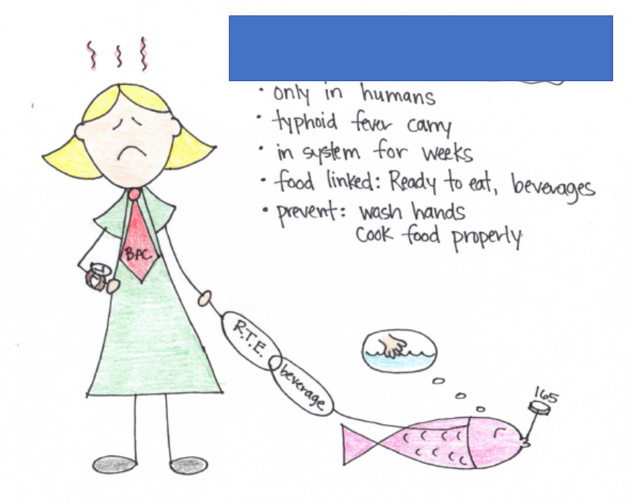
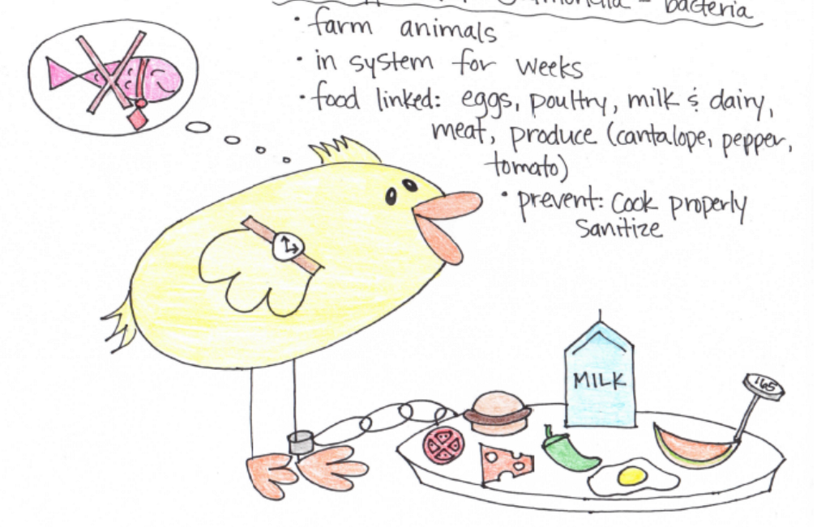
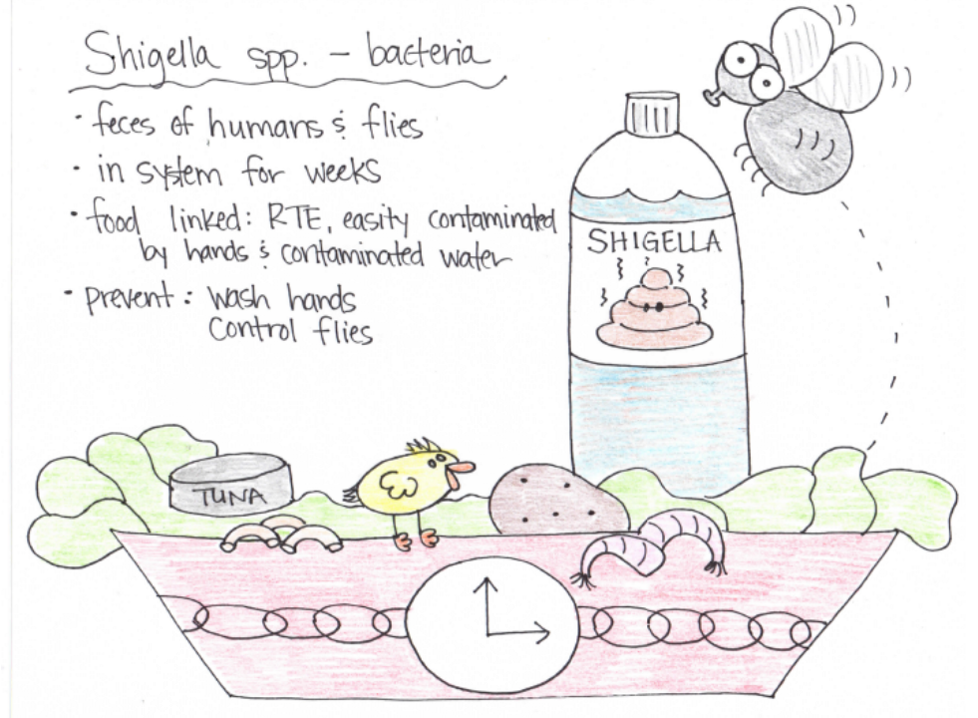
Nontyphoidal Salmonella
Salmonella typhi
Shigella spp.

Slide 7
Shiga toxin-producing Escherichia coli
(E. coli)
Hepatitus A
Norovirus

Slide 8
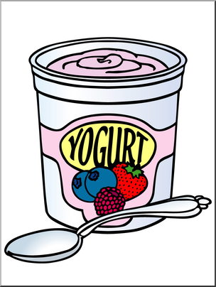
FAT TOM
Temperature Danger Zone
Jaundice
Food
Acidity
Temperature
Time
Oxygen
Moisture
Yellowing of the skin and eyes
41°– 135°
(6 conditions needed for bacteria growth)

Slide 9
Common Food-borne illness symptoms
Big 6
4 types of pathogens
Shigella spp.
Salmonella typhi
Nontyphoidal Salmonella
Shiga toxin-producing Escherichia coli (e.coli)
Hepatitus A
Norovirus
Diarrhea
Vomiting
Fever
Nausea
Abdominal cramps
Jaundice
Bacteria, viruses, parasites, and fungi

Slide 10
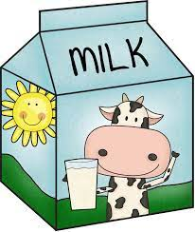
Biological Toxins
Fungi
Chemicals
Includes yeasts, molds, and mushrooms.
Purchase all mushrooms from reputable supplier
Must be approved for use in a foodservice operation.
Store away from prep areas, food-storage areas and service areas.
Never store above food for food contact surfaces.
Naturally associated with certain plants, mushrooms and seafood
Cannot be destroyed by cooking or freezing.
Purchase from reputable supplier.

Slide 11
Food Defense Program
Big 8
Food Allergen
ALERT
(Assure, Look, Employees, Reports, Threat)
Protein in a food or ingredient that some people are sensitive to.
Milk
Soy
Eggs
Wheat
Fish
Crustacean Shellfish
Peanuts
Tree nuts

Slide 12
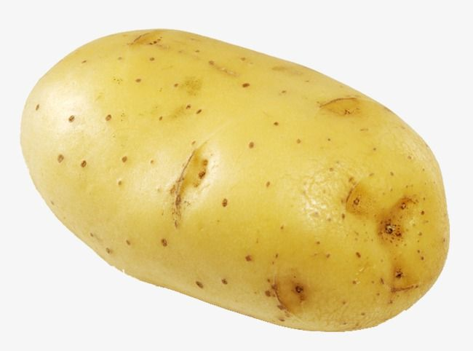
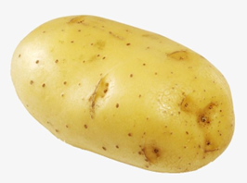
Common Allergy Symptoms
Prevent Allergic Reactions
(Service Staff)
Prevent Allergic Reactions (Kitchen Staff)
Nausea
Wheezing or shortness of breath
Hives or rash
Swelling
Vomiting and/or diarrhea
Abdominal pain
Itchy throat
Describe dishes
Identify ingredients
Suggest menu items that are safe
Identify the order as a special order
Check recipes
Wash, rinse, sanitize hands, surfaces and utensils.
Keep food separate

Slide 13
Time-temperature abuse
Cross-contamination
Food-handling mistakes
Food that stays too long at a temperature ideal for the growth of pathogens.
Pathogens can be transferred from one surface or food to another.
Purchasing from unsafe sources
Failing to cook correctly
Holding food at incorrect temperatures
Using contaminated equipment
Practicing poor personal hygiene

